Slide 1

Disability, accessibility, personalisation, inclusion and design
BCS Bedford November 2016
Notes:
Good Evening

Slide 2
Introduction
I am Peter Abrahams
Secretary of the Digital Accessibility Specialist Group
Member of the Best Practice Committee
50 Years in IT
Last 10 in Accessibility
My aim today
Introduce digital accessibility
Encourage you to promote it
Presentation to insert name here
Notes:
I am Peter Abrahams, I am the Secretary of the Digital Accessibility Specialist Group, Member of the Best Practice Committee and 50 years in IT, last 10 in accessibility
Non PC person with a disability not a disabled person, blinks, VIPs otherwise able spastic.

Slide 3
BCS Strategy
The BCS Strategy
“Making IT good for society ”
David Evans
Director, Policy and Community, BCS
Presentation to insert name here
Notes:
Let me start at the top.
David Evans, The BCS Strategy is 'Making IT good for society'.

Slide 4
Society
Society must mean all of Society
BCS must include everyone
In particular we must include people with disabilities
Presentation to insert name here
Notes:
My understanding is that when he says society he means all of society and that the BCS must include everyone in society.
I would suggest that Community and Society are synonymous in this context. Therefore the Community Officer has a major role in this strategic objective.
To be able to do this we need to recognise who may be excluded.

Slide 5
Digital Inclusion
Social
Inclusion
- Race
- Religion
- Gender
- Orientation
- Age
Inclusive Society
Inclusive Profession
Inclusive Group
Disability
Inclusion
- Movement
- Vision
- Hearing
- Cognition
Inclusive
BCS
Technical
Inclusion
- Access to HW
- Fast broadband
- Training
Group
Presentation to insert name here
Notes:
Tonight I am concentrating on disability

Slide 6
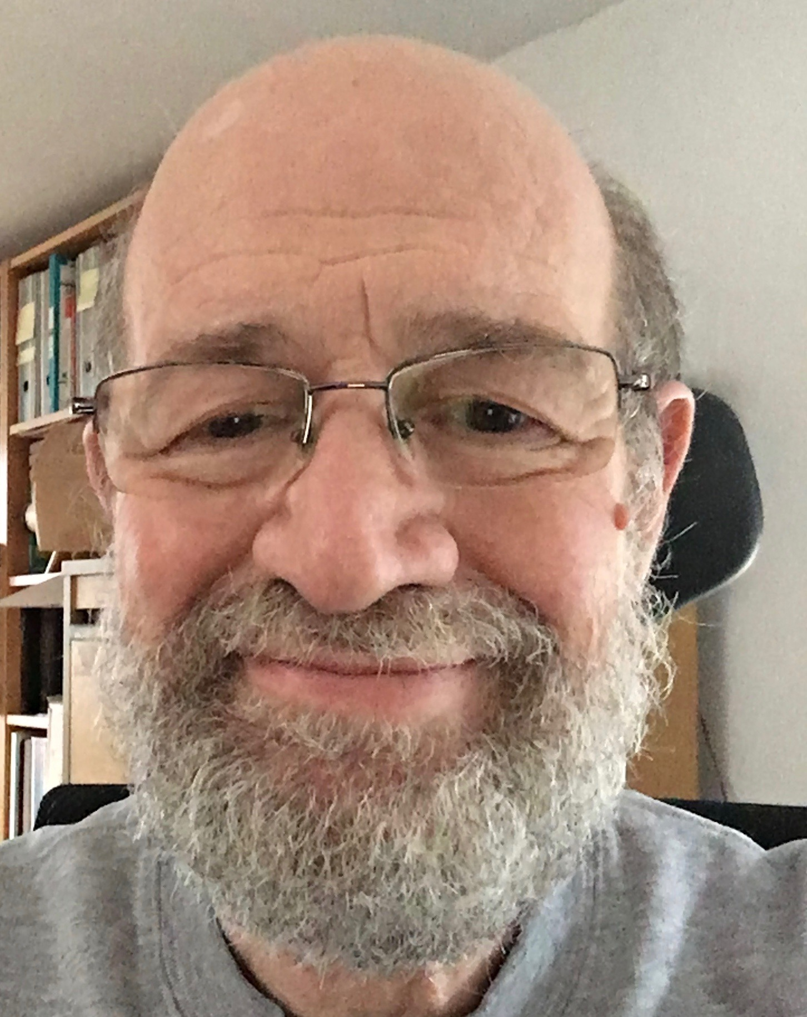
Disability
Am I disabled?
Notes:
Glasses
Hearing Aids
Mild RSI
Mild protan colour blindness
I am less able but not disabled.
Assistive technologies (glasses and hearing aids) make me almost average able.

Slide 7

Colour Blind
Notes:
I cannot see a number in the left circle can you?
I can see the 7 in the right circle.

Slide 8
Colour Blind 3?
Notes:
I can sometime see a 3 in this circle but not always.

Slide 9
Ability Spectrum
Ave-
Super-
Less-
Dis-
Non-
Permanent
Situational
Temporary
Notes:
So we are all on a ability spectrum, different places for different abilities.
Registed disabled people are to the left.
Some people have super ability sportsmen, rocket scientists, perfumerers, colour specialists.
Some abilities are permanent , some teporary (broken arm) some situational noisy environment, driving a car.

Slide 10
Why?
Moral – the right thing to do
Financial – reaches everyone
Legal – potential for court case
Inclusive – better for everyone
Notes:
Why should we care about accessibility:
Financial there are 7 Million registered disabled in the UK with spending power and job potential.
Equality act, reasonable adjustment, international laws.

Slide 11
Accessibility
Computing
for
people
with
disabilities

Slide 12
Accessibility
Computing
for
people
with
disabilities
Assistive
Technology
Inclusive Design
Notes:
Assistive technology includes:
Text to speech
Voice recognition
Braille output
Special pointing devices
Predictive textZoom
Switches (Hawkings)
Spell check grammar check
But systems have also be designed to be easy to use by everyone and to enable AT to work correctly.

Slide 13
Check Contrast
Notes:
Examples of bad design. Actually difficult for most people but impossible for some. A situation where a screen reader user has an advantage.
Couple of videos of good web design:
tabbing in logical order and zooming text only.
Note videos do not have captioning so as shown they are not useful for people who are deaf.

Slide 14

Images
Notes:
Here is a email with a =n image of an invitation.
Fine if you are sighted but a screen reader will only say that there is an image but not what is in it.
Also a problem for any user because you cannot copy the address on the image into your diary.

Slide 15
Documents
Notes:
Documents need to be accessible. Helpful to screen reader users to know what is a heading and what is text and to be able to jump from heading to heading.
Useful to everyone to navigate around documents.

Slide 16
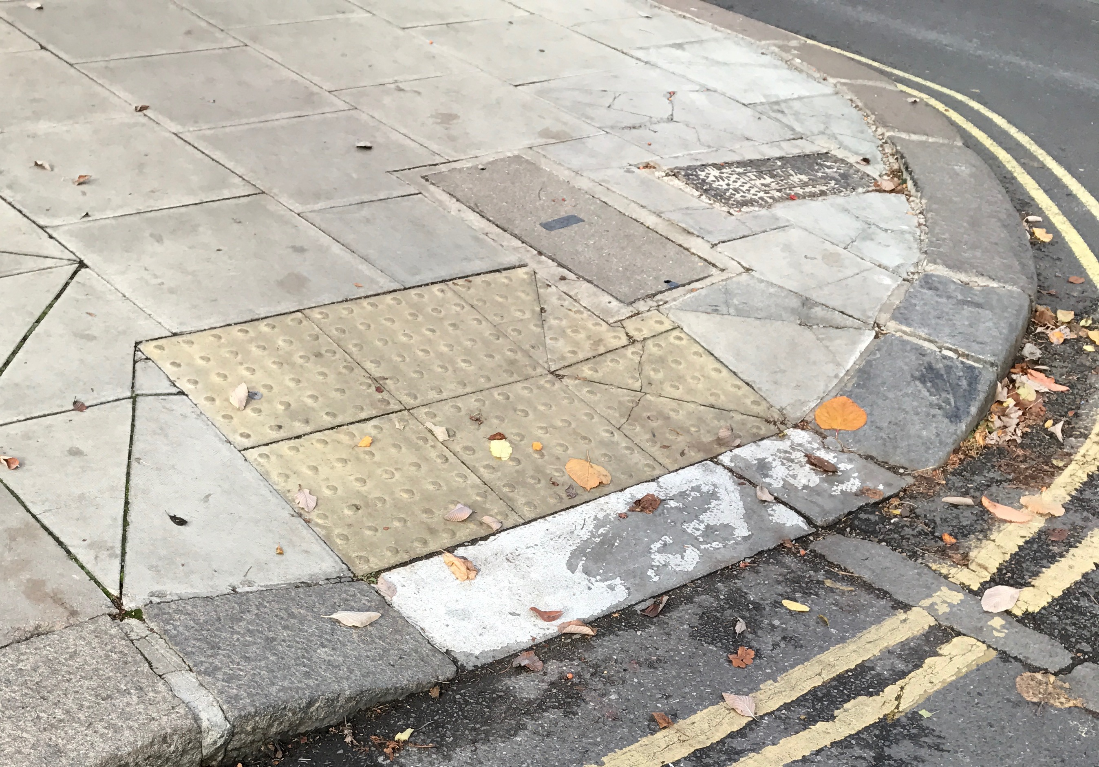
Drop kerb a11y
Notes:
A drop kerb is a bit of inclusive design.
Essential for assistive technologies (wheelchairs and mobility scooters) but useful to many pram pushers, suitcase wheelers, deliverers.
Digital Inclusion is creating the drop kerbs in the digital environment.

Slide 17
UK Stats
7 million working age are registered disabled
Of those only 45% in work (cf 80% of overall population)
11 million below digital skills threshold
Notes:
There are currently
11 million people
in the UK below the digital skills threshold, which is defined as:
Send and receive emails
Use a search engine
Brows the internet
Fill out an online application form

Slide 18
Accessible to Whom
Customers
Clients
Students
Employees
Developers
Designers
Elders
Notes:
Think of all the types of people who might use your system.

Slide 19
Simple A11y Checks
Correct tab sequence
Zoom text
Captions on videos
Alternate text for pictures
Accessible PDFs
Fast Flashing
Check Contrast
Notes:
How to start
Here are a few checks you can do.
The following pages give an initial list for more information.

Slide 20
Education
Digital Accessibility MOOC
BCS Digital Accessibility -Web Essentials
First Seven Steps to accessible websites
First Seven Steps to accessible mobile apps
Notes:
Massive online open courses created by Southampton Uni.
Links on reference page

Slide 21
Useful Organisations
BCS Digital Accessibility SG
Business Disability Forum
AbilityNet
Open Inclusion
AXSChat

Slide 22
Useful Links
Cambridge University Inclusive Design Toolkit
Colour blindness Test
Understanding WCAG 2
Webaim WAVE
BS 8878: 2010 - Web accessibility code of practice

Slide 23
Inclusive
Thinking about accessibility
Creates accessible systems
Creates more usable systems
Essential for some
Better for all

Slide 24
Questions
Thank you
Questions

