Slide 1
Risk Attenuation and Management in Software Projects
Geoffrey Darnton
Requirements Analytics

Slide 2
WBS and Milestones
Break the whole project down into smaller ‘chunks’ – and sequences
Those ‘chunks’ constitute the Work Breakdown Structure
Allocate people and resources – compute the project timescale
Schedule the WBS and decide which milestones to check
Hold project management meetings to check progress against those milestones

Slide 3
Waterfall Model the Origin?
Waterfall model based on millennia of experience
‘Problem’ -> Concept -> Analysis -> Design -> Implement -> Test -> Deploy -> Retire
One of the most common and widely cited articulations of the Waterfall Model is that of Winston W. Royce** of TRW – of course, this was contextualized for software development
**Proceedings, IEEE WESCON, August 1970, pp1-9.

Slide 4
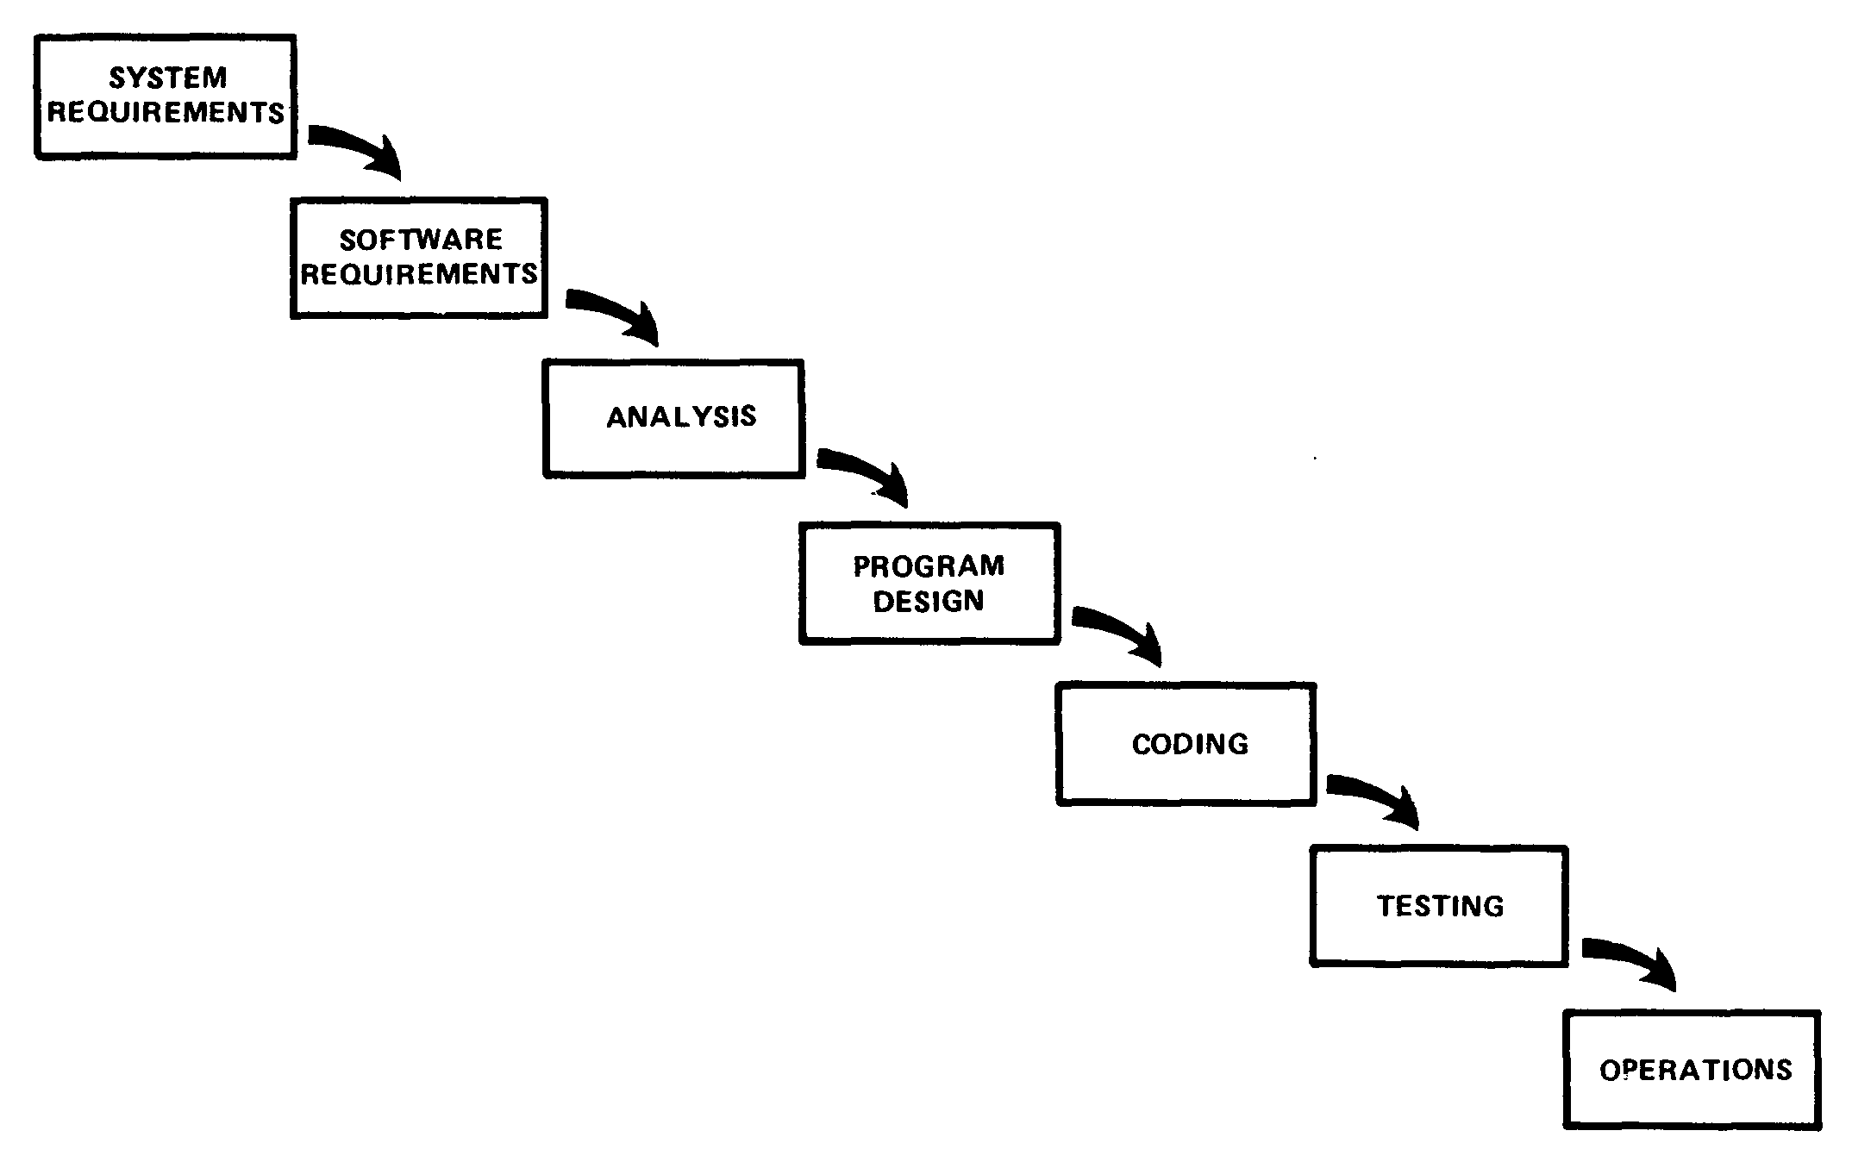
Royce Waterfall Model

Slide 5
Waterfall Experiences
Original paper does allow for various forms of iteration
Adopted by many organizations for their software development project management
Assumes a good understanding of requirements very early in the project
Project problems are usually identified very late in the project

Slide 6
Go Walkabout on the Moon?
Some interesting scenarios (with acknowledgements to Barry Boehm)
Satellite into the Atlantic Ocean
Portable army missile control system with an ‘undo’ button
Software to support going walkabout on the moon

Slide 7
The Professor and his Model Trains
An engineering professor had a model railway system in his university lab.
Was this because he had a frustrated childhood with parents who couldn’t afford model railways when he was a child, but now he has a good salary and can afford them?
No – the British and French, after more than 100 years of discussions, agreed to build a railway tunnel joining the countries.
So, why play with trains? – find out in the presentation and discussion!

Slide 8
Scenario Observations
The previous scenarios involve either serious errors that crept into the implementations, or requirements that need very careful understanding, clarification, and maybe project re-scoping
There are two critical project dimensions to think about:
Novelty
Complexity

Slide 9
The Millennium Bridge
The Millennium Bridge is a new footbridge across the Thames in London built as part of the celebrations for the new millennium.
It is a footbridge.
Humans have been building footbridges for thousands of years.
Therefore, there is a huge amount of experience available building footbridges

Slide 10
Millennium Bridge from Tate Modern
Obtained from Wikipedia article about the Millennium Bridge, at:
http://en.wikipedia.org/wiki/Millennium_Bridge,_London

Slide 11
It Wobbled!
There was nothing in the requirements suggesting it should wobble when people walk over it.
On the first 2 days after opening on 10-Jun-2000 it wobbled. Then it was closed for 2 years to eliminate the wobble!
The problem did not emerge until extremely late in the project cycle (deployment!) – a key symptom of a defective project management method.

Slide 12
Bridge Diagnosis
Although humans have been building foot bridges for thousands of years, the Millennium Bridge was high in novelty and complexity.
According to Wikipedia: “In the case of the Millennium Bridge, because the lateral motion caused the pedestrians loading the bridge to directly participate with the bridge, the vibrational modes had not been anticipated by the designers”.

Slide 13
Fast Forward – Spiral Model
Nearly 20 years after Royce’s Waterfall Model, Barry Boehm published his Spiral Model for Software Development (BB also worked for TRW).
This is based on recognition that in the early stages of a project, there may be items in the requirements wish list that are extremely difficult to satisfy, and some may be impossible given the current state of technology (or resources available).
Therefore, WBS and milestones moved to Risk identification and attenuation.

Slide 14
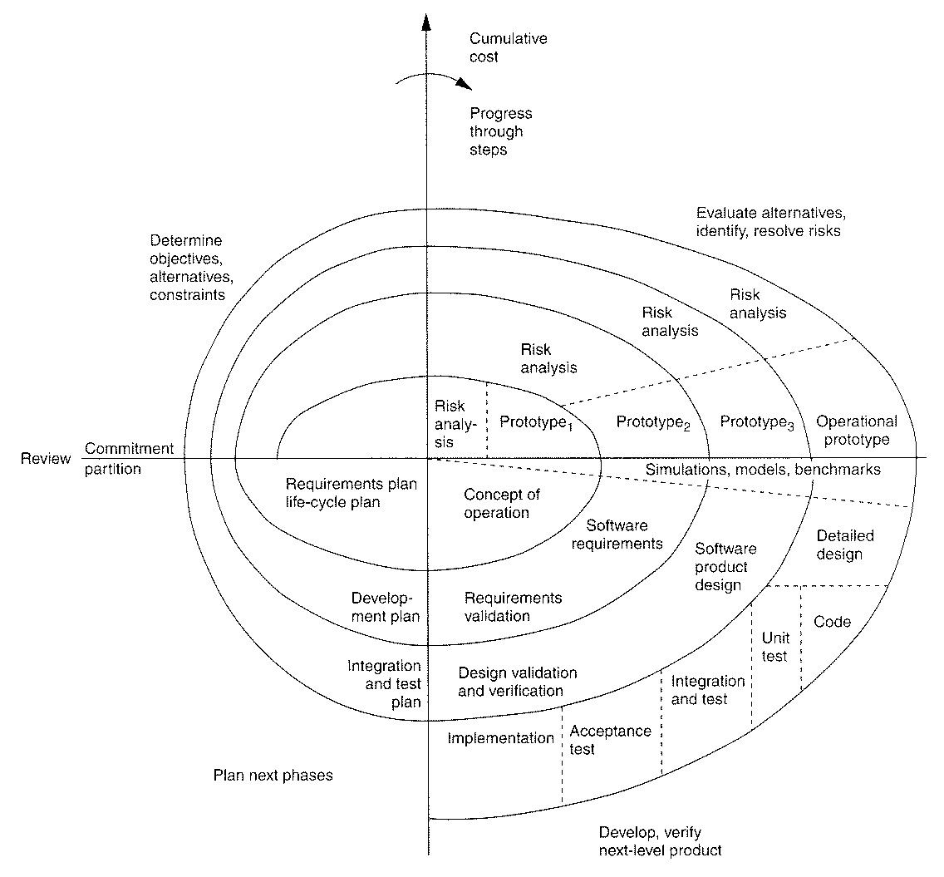
Spiral model of the software process (Boehm 1988)

Slide 15
Using the Spiral Model
Project meetings to check progress against milestones are scrapped.
They are replaced by project management meetings to discuss highest priority difficulties, assign responsibility for investigation, and review the project in the light of experience trying to solve problems.
Re-scope the project if necessary.

Slide 16
Managers vs Techies
Managers love the waterfall model – it gives the illusion of good project progress as milestones are ticked off – they don’t like the spiral model as it is less clear what’s being obtained for the money after different periods of time.
Techies prefer the Spiral Model because it recognizes the inherent uncertainties and risks.

Slide 17
Standards (1)
Many organizations proceed by choosing or designing a project development method – i.e. one method per organization.
Different problems need different methods – therefore it may be necessary to have one method per project.
See IEEE Std 1074 - Standard for Developing a Software Project Life Cycle Process

Slide 18
Standards (2)
If a problem can be solved with known and experienced approaches, a Waterfall Model may be the most appropriate.
If a problem is high in novelty or complexity, choose a Spiral Model.
Both a Waterfall and Spiral Model can be compliant with IEEE 1074 (and hence probably ISO 12207).

Slide 19
Summary
Project management methods can be seen on a spectrum from Waterfall at one end to Spiral** at the other. Use complexity and novelty to choose.
After sufficient prototyping, risk identification and management, and project re-scoping, a Spiral ends with a Waterfall.
Move from one method per organization, to one method per project, introducing method engineers to perform project life cycle definitions.
** ‘Spiral’ has evolved to ‘incremental commitment’

